Slide 1


MSP Tech Club - Helwan University
MSP Tech Club - Helwan University
AI Workshop
AI Workshop
This presentation will introduce our AI Workshop, highlighting the content details.
This presentation will introduce our AI Workshop, highlighting the content details.

Slide 2



TABLE OF CONTENTS
1
Pearson correlation coefficient and Simple Linear Regression
6
Normal equation and Polynomial Regression with Python
2
Gradient Descent
7
Overfitting and underfitting
3
Data Normalization
8
Lasso and Ridge Regression
4
Backward Elimination
9
Regularization
5
Multi Regression
10
Feature selection by Lasso Regression

Slide 3
WHAT IS MACHINE LEARNING ?
ML is a form of Artificial Intelligence (AI) that teaches computers to think in a similar way to how humans do: Learning and improving upon past experiences. It works by exploring data and identifying patterns, and involves minimal human intervention

Slide 4

1-Supervised Learning
In Supervised Learning, a machine is trained using 'labeled' data Datasets are said to be labeled when they contain both input and output parameters. In other words, the data has already been tagged with the correct answer .
2-Unsupervised Learning
Uses machine learning algorithms to analyze and cluster unlabeled datasets. These algorithms discover hidden patterns or data groupings without the need for human intervention .
IT CONSISTS OF THREE TYPE :
3-Reinforcement Learning
RL is a type of machine learning technique that enables an agent to learn in an interactive environment by trial and error using feedback from its own actions and experiences

Slide 5
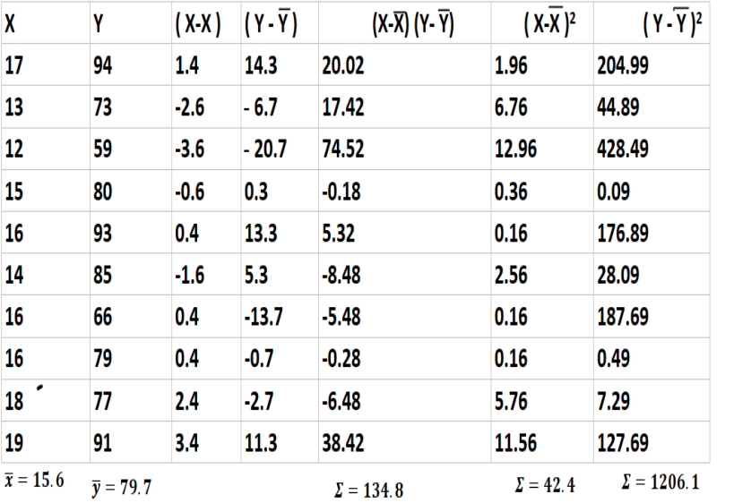
REGRESSION BY USING PEARSON CORRELATION COEFFICIENT :
Measures the statistical association between two continuous variable

Slide 6
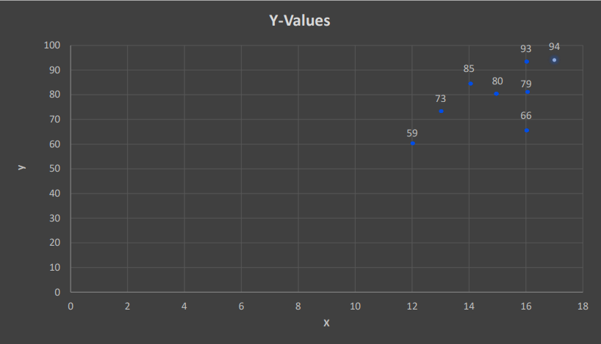

Slide 7
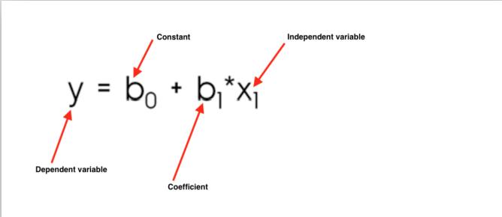
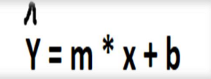
LINEAR REGRESSION EQUATION
M -----------> Slope
X --------------> Feature
B -------------------> y_intercept

Slide 8
PEARSON CORRELATION COEFFICIENT

Slide 9
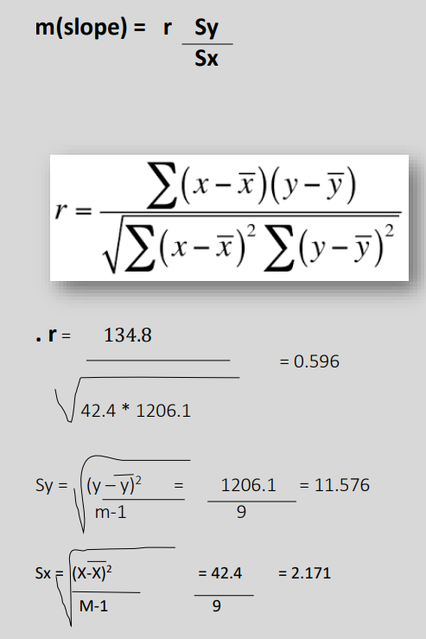

Slide 10
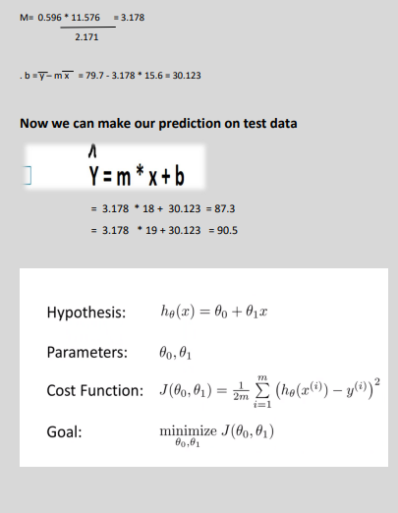

Slide 11
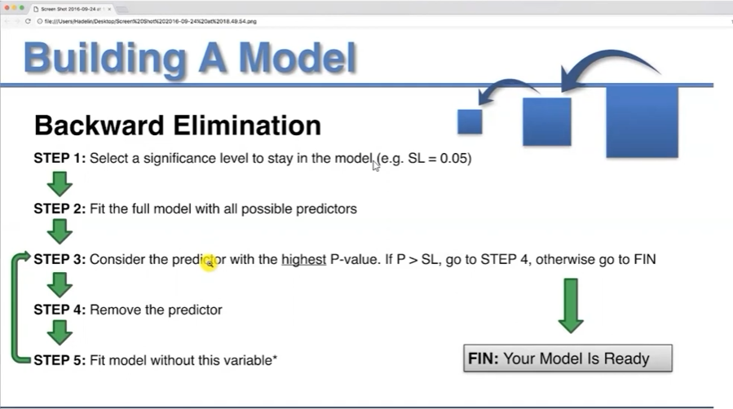

Slide 12
NORMAL EQUATION

Slide 13
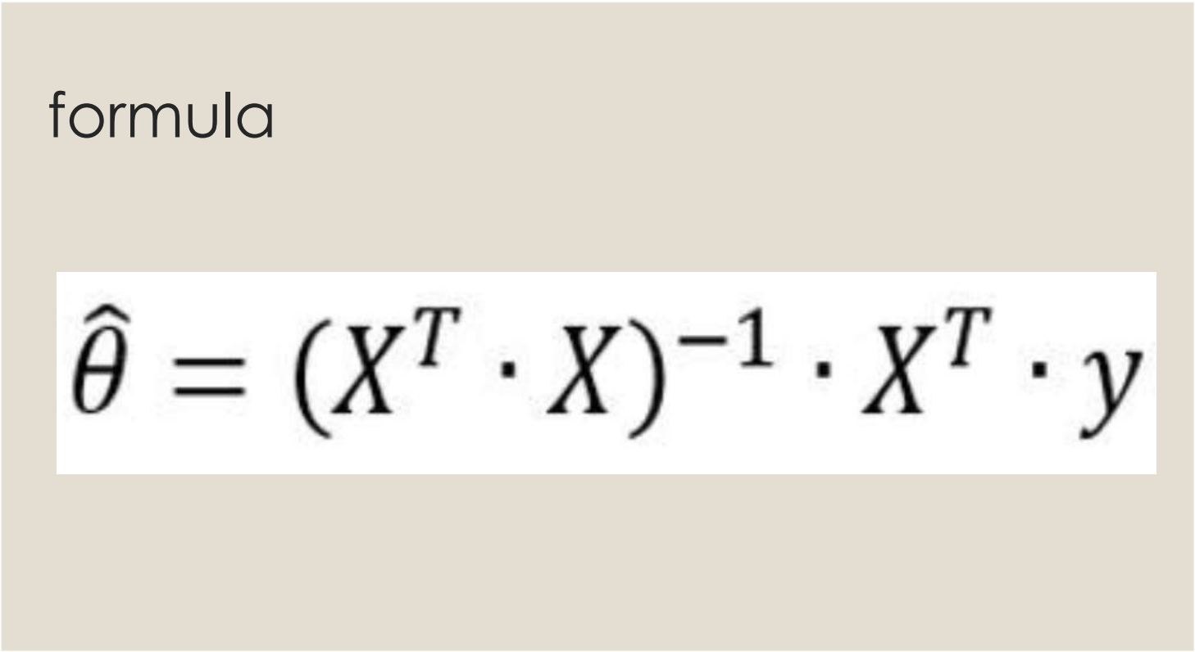

Slide 14
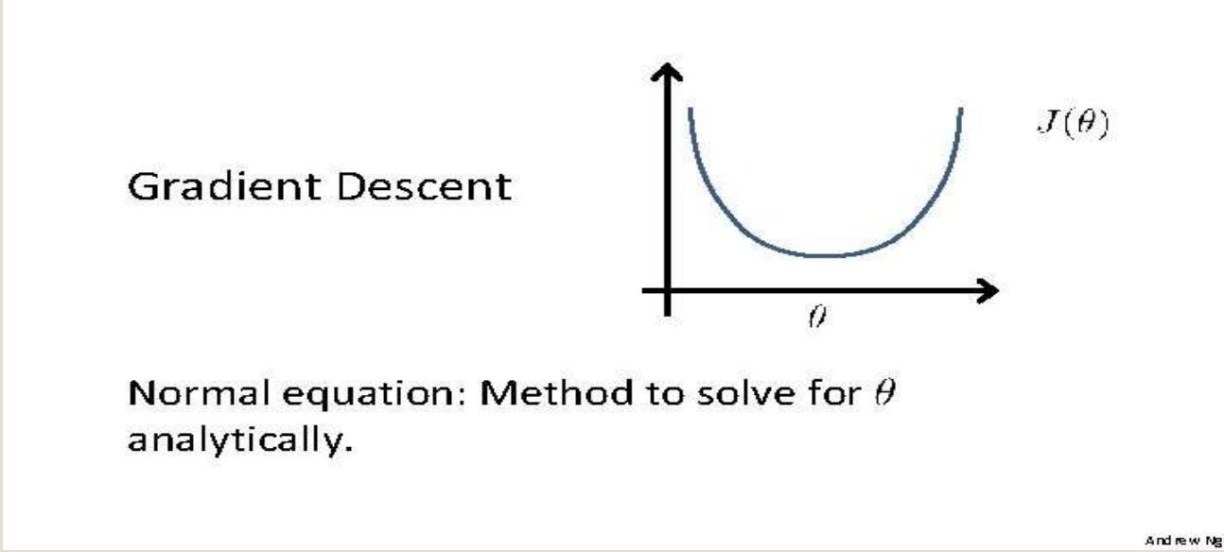
WE USE THE NORMAL EQUATION TO CALCULATE THE OPTIMAL WEIGHTS WHICH LEEDS US TO THE GLOBAL MINIMUM IN ONE STEP

Slide 15
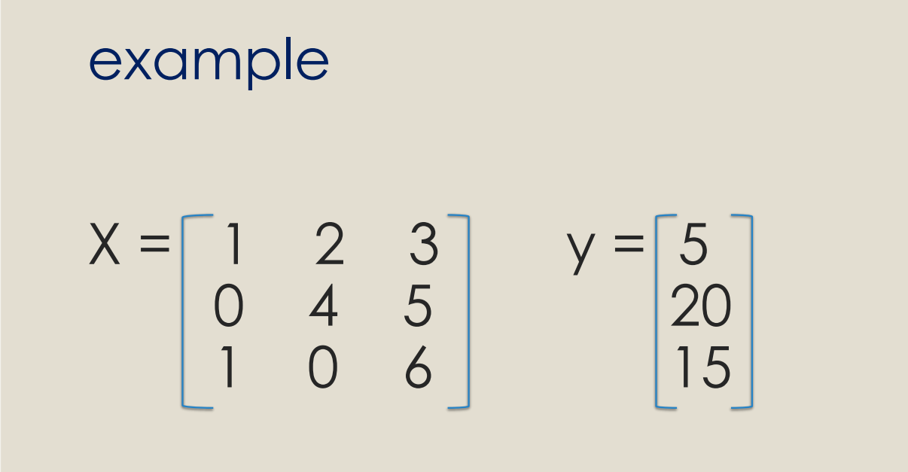

Slide 16
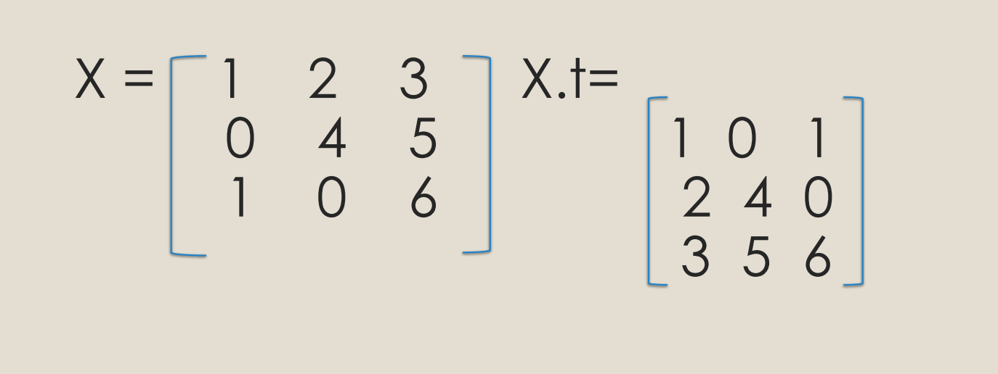

Slide 17
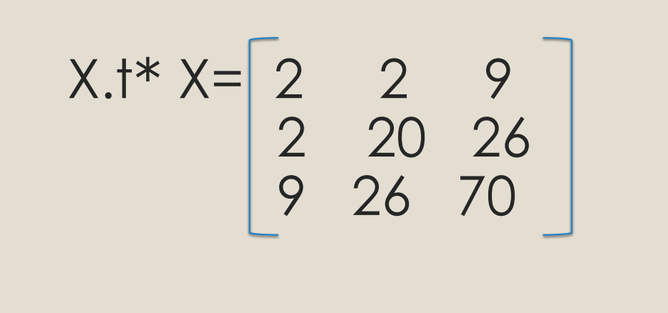

Slide 18
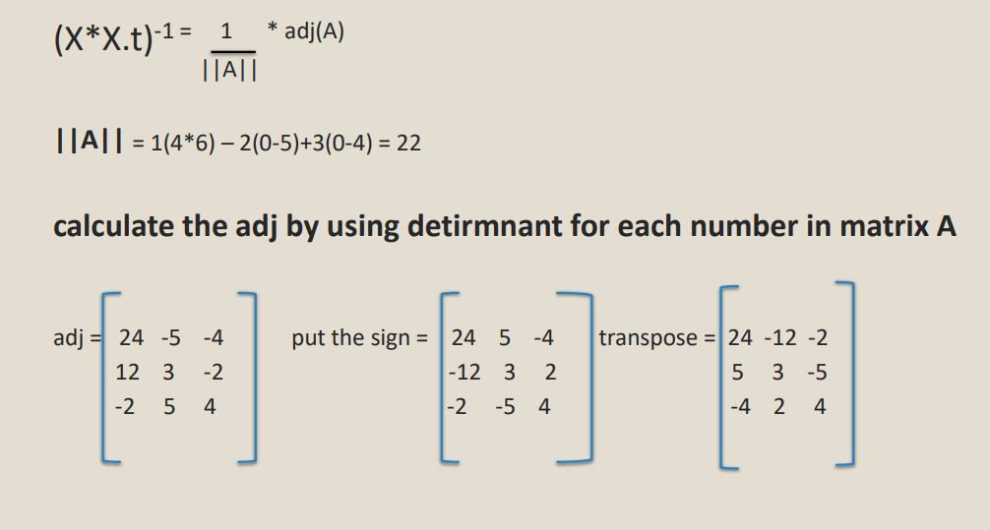

Slide 19
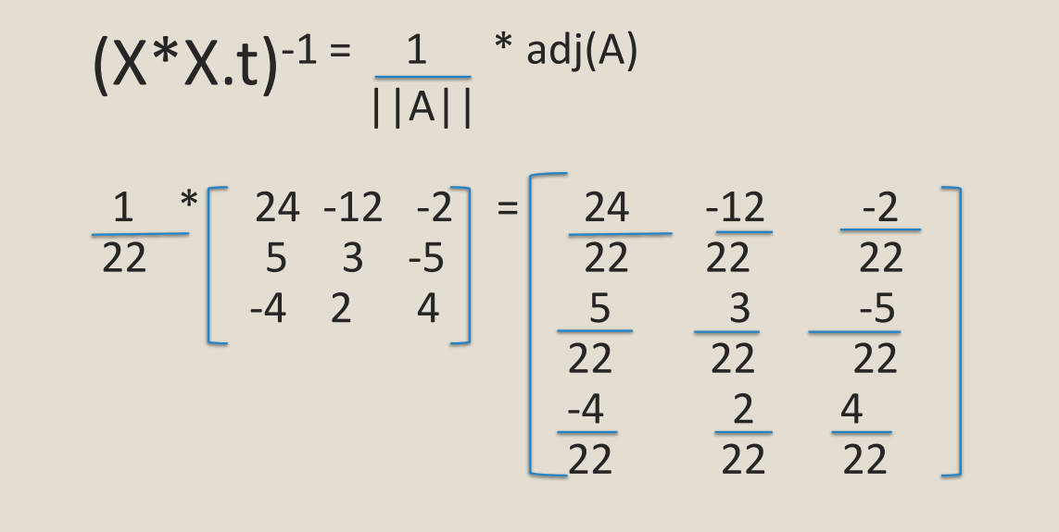

Slide 20
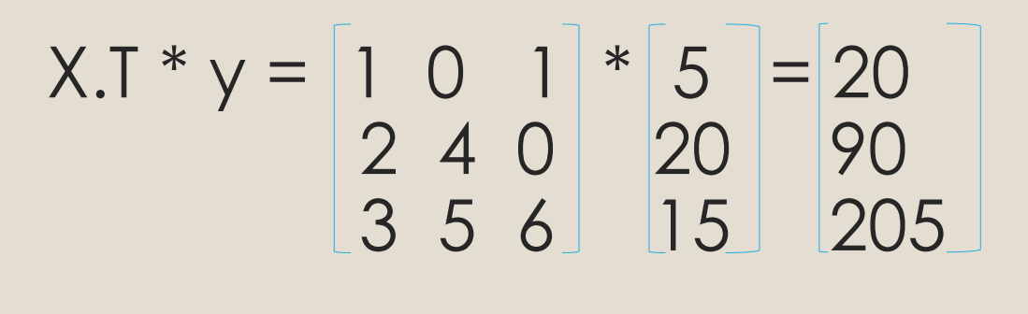

Slide 21
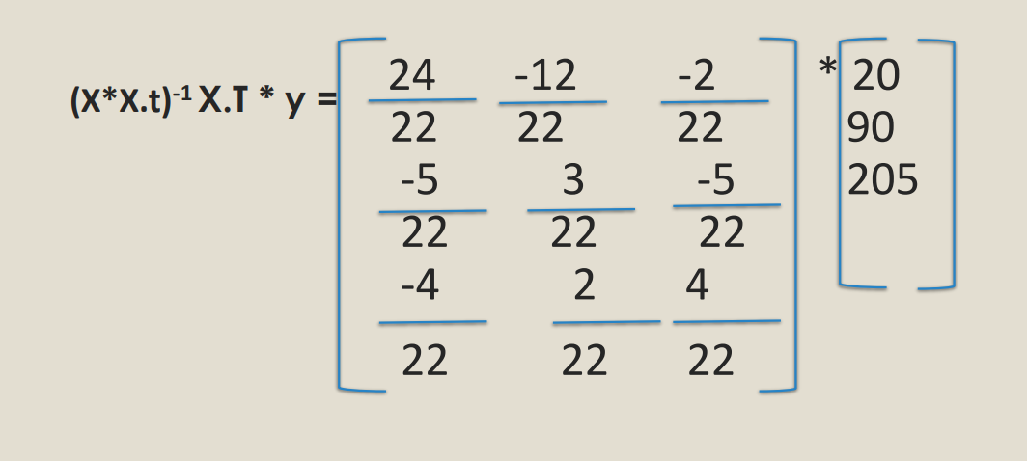

Slide 22
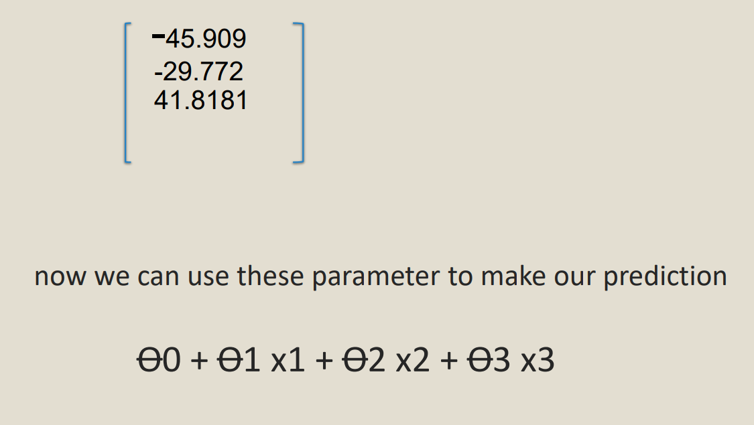

Slide 23
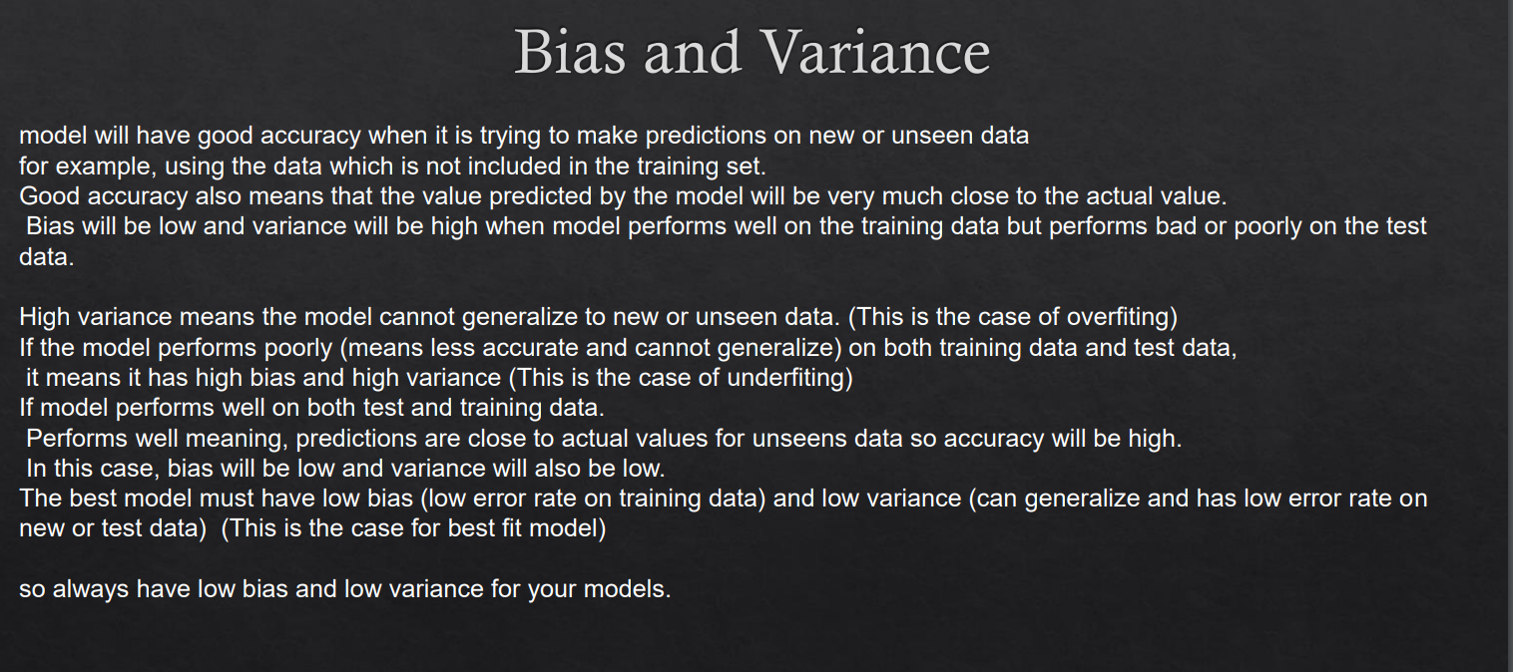

Slide 24
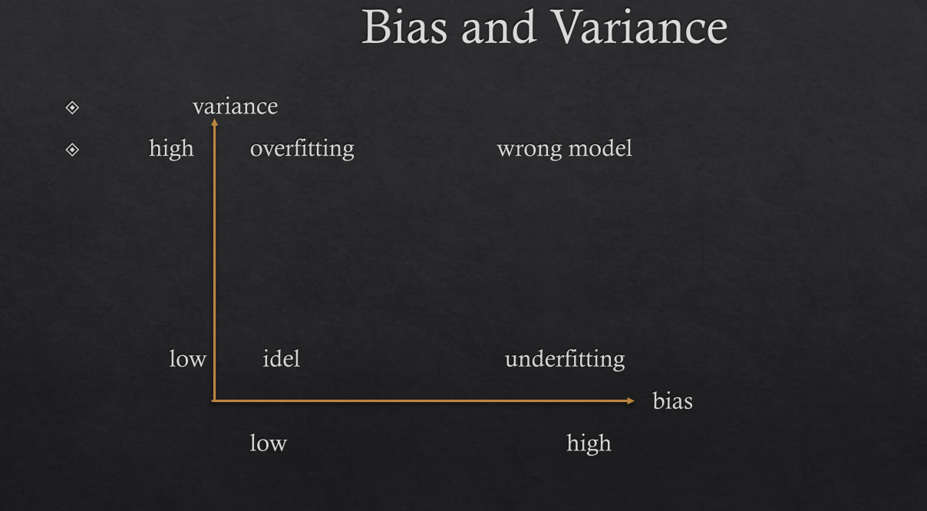

Slide 25
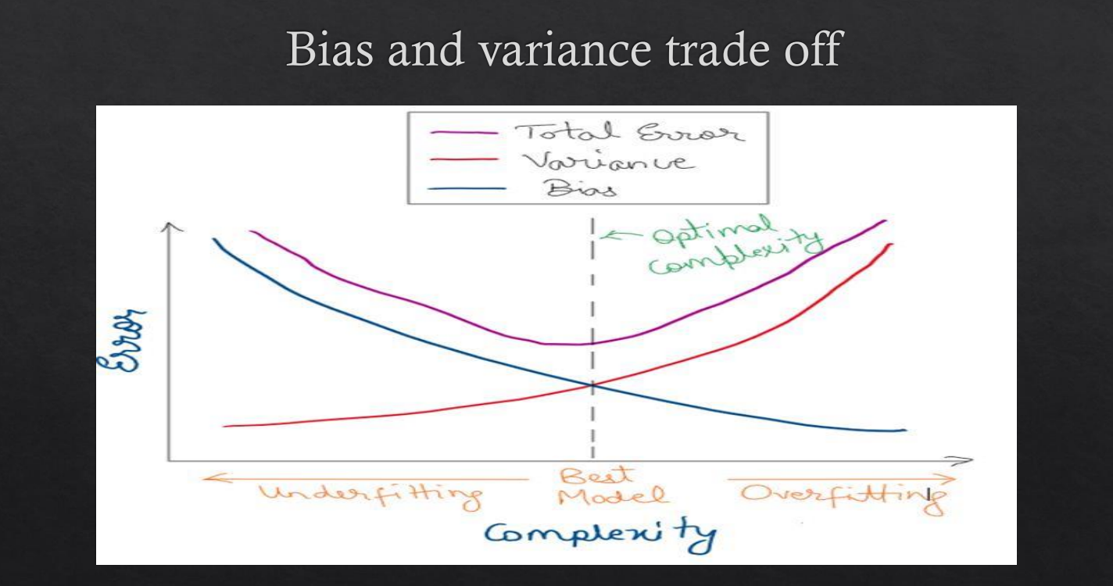

Slide 26
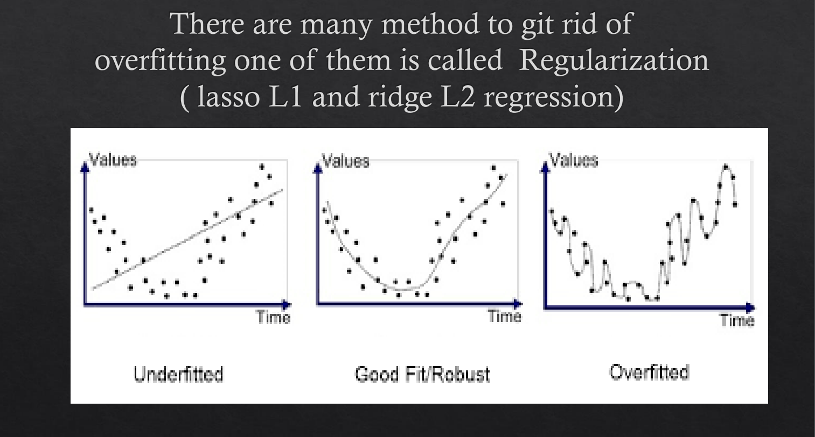

Slide 27
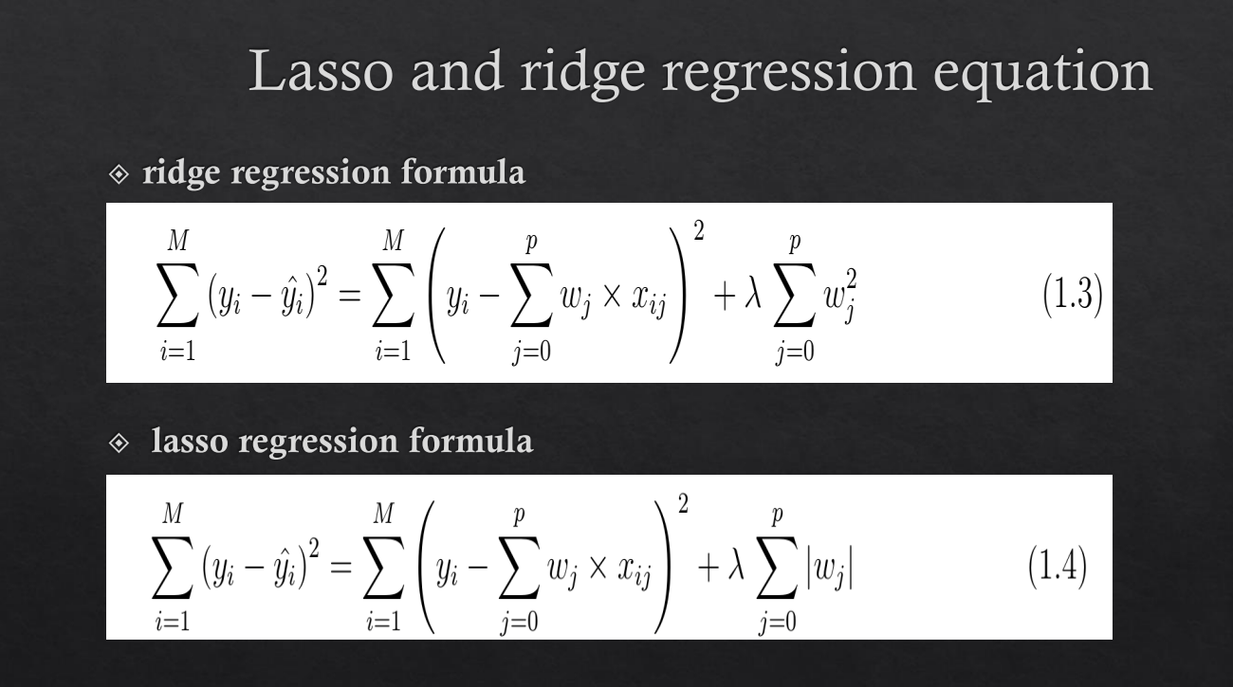

Slide 28
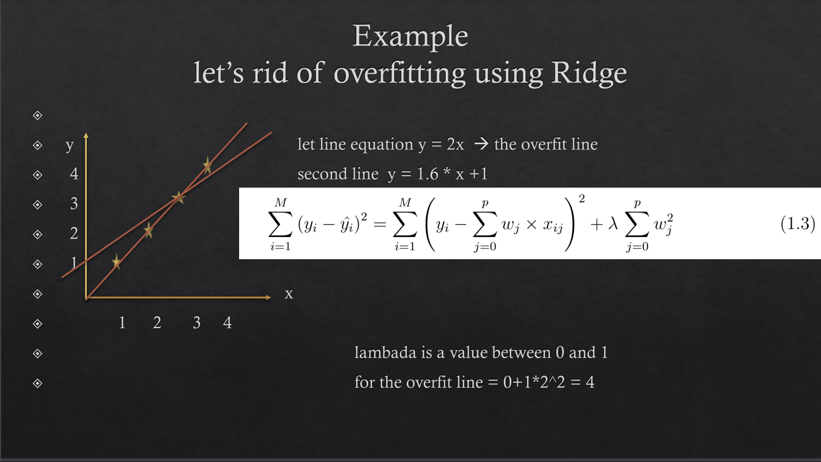

Slide 29
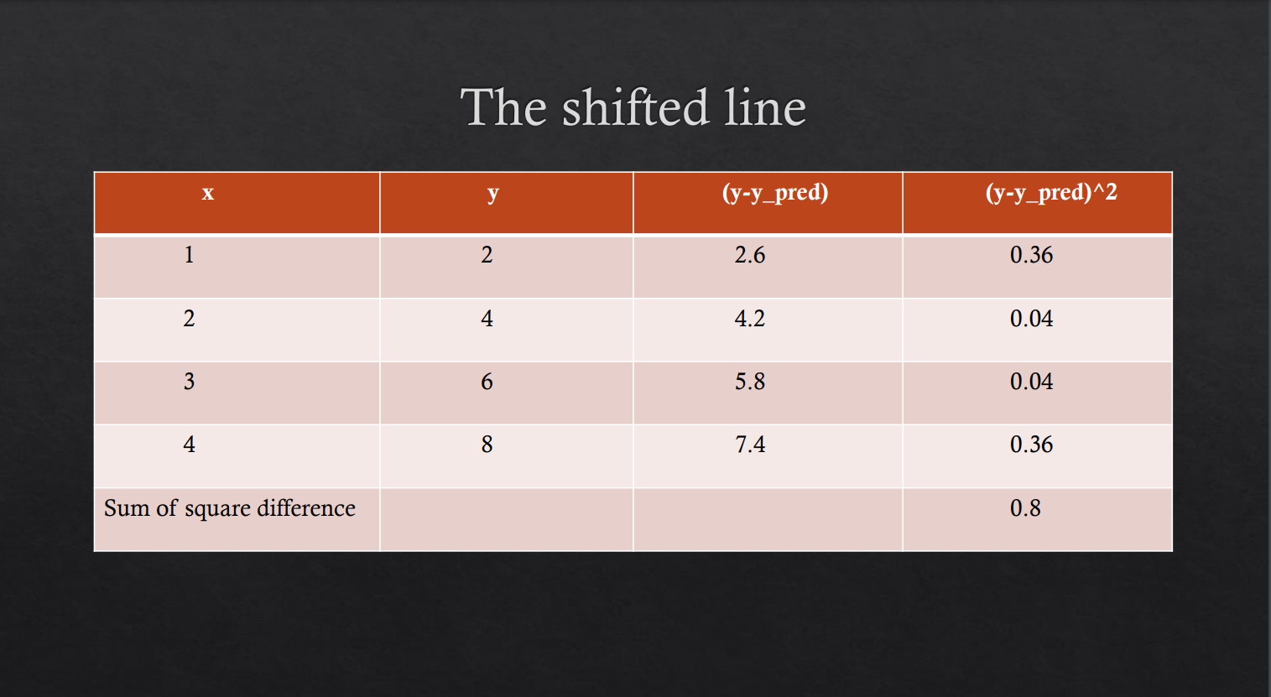

Slide 30
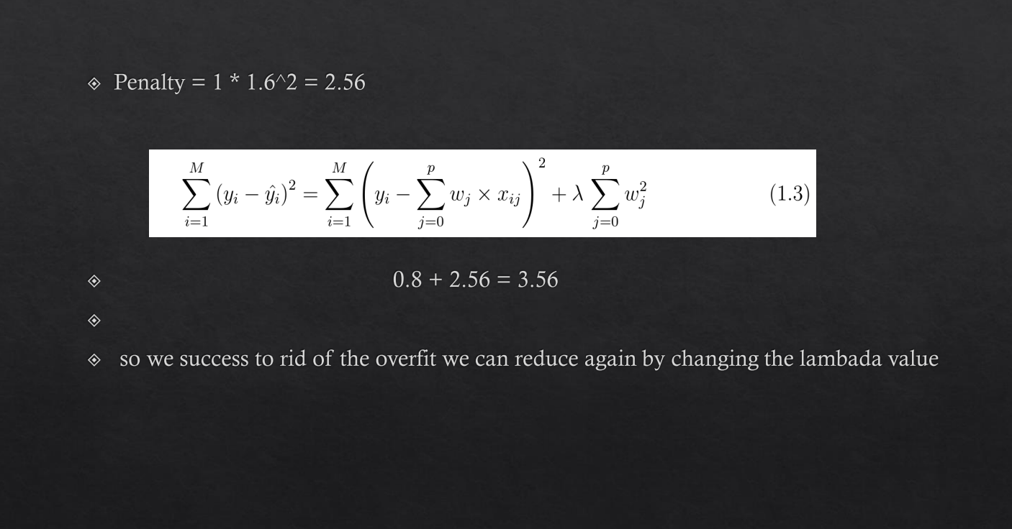

Slide 31
THANK YOU
for your time and attention
Present by MSP AI Committee

